Slide 1

Learning Objectives
Who was involved?
Which experiments were used to help us understand?
What are atomic line spectra?
Which models were used to represent the atom?
Which equations are fundamental?
Which ones are handy to know?!
What have been the successes of quantum theory?
What are the future applications?
Free powerpoints at http://www.worldofteaching.com

Slide 2
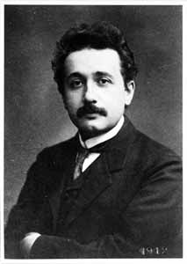
Albert Einstein 1879-1955
We believe in the possibility of a theory which is able to give a complete description of reality, the laws of which establish relations between the things themselves and not merely between their probabilities ... GOD DOES NOT PLAY DICE.

Slide 3
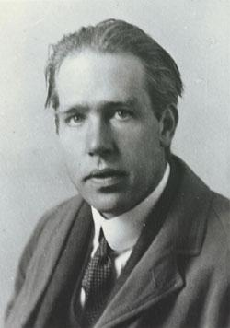
Niels Bohr 1885-1962
Einstein, DON'T TELL GOD WHAT TO DO!
Those who are not shocked when they first come across quantum mechanics cannot possibly have understood it.

Slide 4
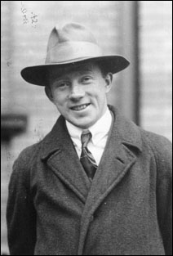
Werner Heisenberg 1901-1976
We have to remember that what we observe is not nature itself but nature exposed to our method of questioning.
I, at any rate, am convinced that HE IS NOT PLAYING AT DICE.

Slide 5
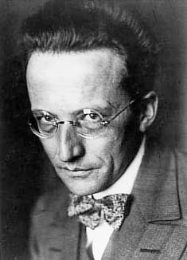
Erwin Schroedinger 1887-1961
I do not like it, and I am sorry I ever had anything to do with it.
Had I known that we were not going to get rid of this damned quantum jumping, I never would have involved myself in this business!

Slide 6
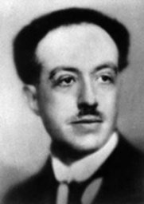
Prince Louis de Broglie
1892-1987
Electrons should not be considered simply as particles, but that frequency must be assigned to them also.
(1929, Nobel Prize Speech)

Slide 7
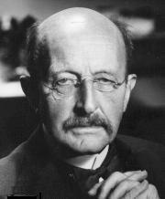
Max Planck 1858-1947
Physics is finished, young man. It's a dead-end street.
(from an unknown teacher to Planck considering Physics at the turn of the 20th century!)

Slide 8
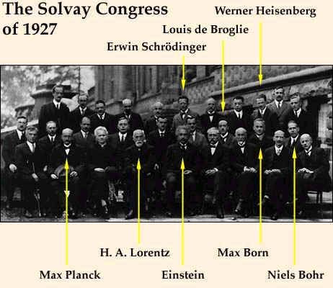

Slide 9
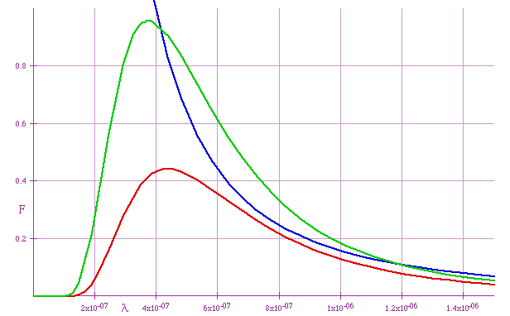


THE ‘ULTRAVIOLET CATASTROPHE’
1900 - Rayleigh
This was a CLASSICAL prediction, first made in the late 19th century, that an IDEAL BLACK BODY at thermal equilibrium will emit radiation with INFINITE POWER.
Max Planck resolved this issue by postulating that electromagnetic energy did not follow the classical description, but could only oscillate or be emitted in DISCRETE PACKETS OF ENERGY proportional to the frequency. He called these packets ‘QUANTA’.
Note:

Slide 10
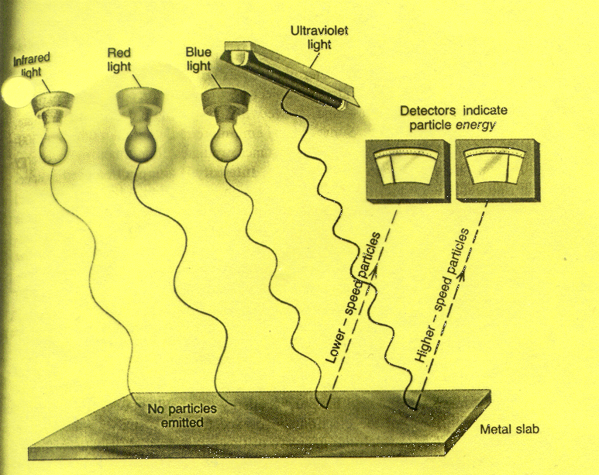

THE PHOTOELECTRIC EFFECT
1905 - Einstein
The emission of electrons from a surface (usually metallic) upon exposure to, and absorption of, electromagnetic radiation.
The photoelectric effect was explained mathematically by Einstein who extended the work on QUANTA as developed by Planck.

Slide 11
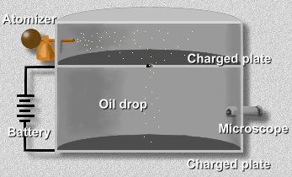


MILLIKAN’S OIL DROP EXPERIMENT
1909 - Robert Millikan
This experiment determined the magnitude of the electronic charge, and that it was QUANTISED.
This value is approximately
Note: An electron volt (eV) is the amount of energy it takes to accelerate one electron through a potential of one volt. Thus, 1eV

Slide 12
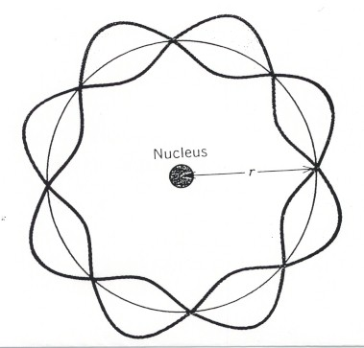
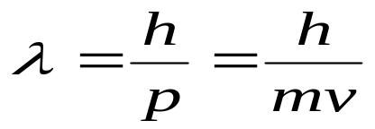
DE BROGLIE WAVELENGTH
Prince Louis de Broglie - 1932
De Broglie discovered that all particles with momentum have an associated wavelength.
What is the wavelength of a human being, assuming he/she weighs 70 kg, and is running at 25 m/s?

Slide 13
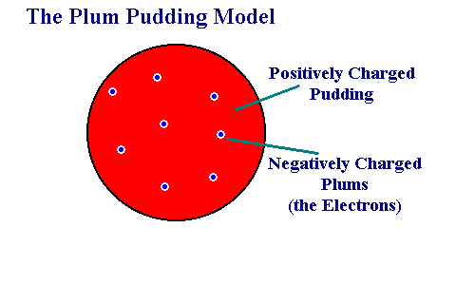
NUCLEAR ATOM STRUCTURES
1898 - Thomson

Slide 14
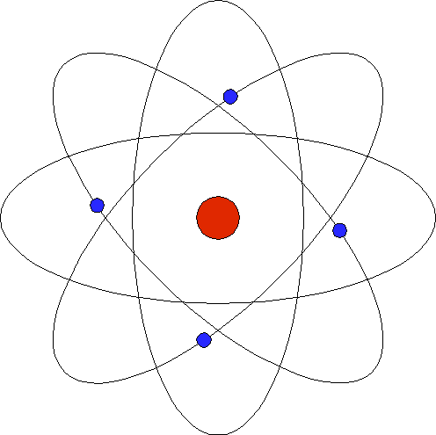
1911 -Rutherford

Slide 15
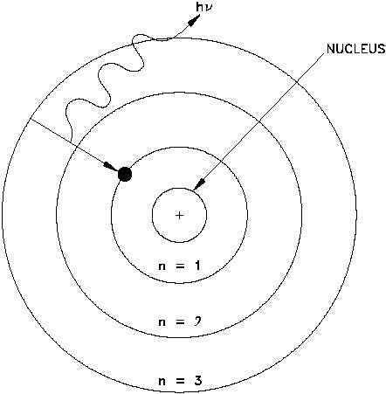
1913 - Rutherford/Bohr

Slide 16
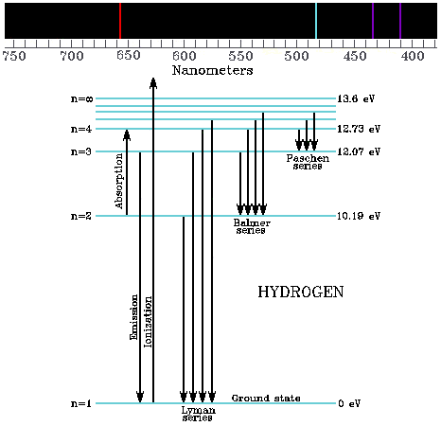
Atomic Line Spectra

Slide 17
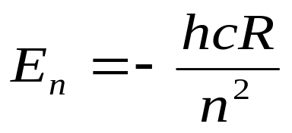
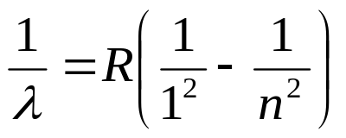
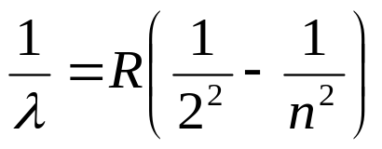
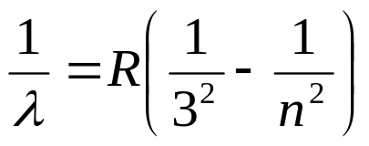
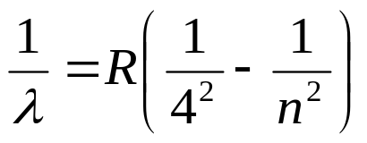
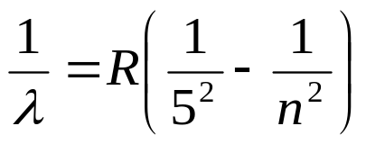
General expression:
Lyman: n>1 (ultraviolet)
Balmer: n>2 (visible)
Paschen: n>3 (infrared)
Brackett: n>4 (infrared)
Pfund: n>5 (infrared)

Slide 18
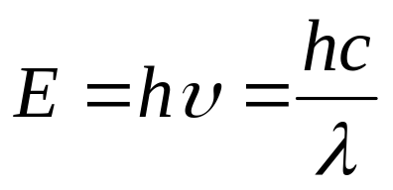
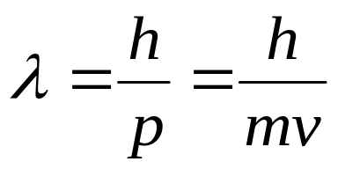
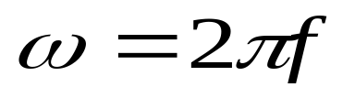
SUMMARY OF IMPORTANT EQUATIONS
Energy and frequency:
The photoelectric effect:
De Broglie wavelength:
Angular frequency:

Slide 19
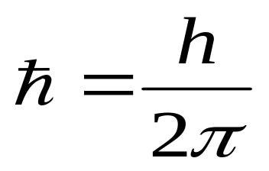
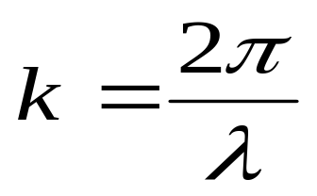
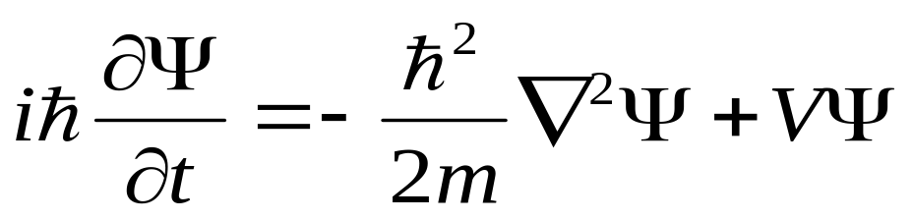
Equations of interest
(non-examinable!)
Planck’s constant:
Wave vector:
Schroedinger:

Slide 20
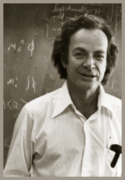
Richard Feynman 1918-1988
Anyone who has not been shocked by quantum physics has not understood it.
The word 'quantum' refers to this peculiar aspect of nature that goes against common sense.

Slide 21
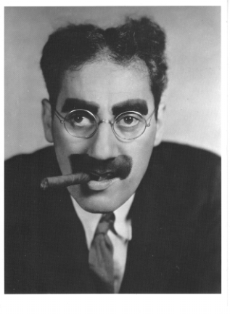
Groucho Marx 1890-1977
Very interesting theory - it makes no sense at all!

Slide 22
QUANTUM THEORY
Uses
LASERs
Semiconductors
Transistors
LED
Night Vision Goggles
CCD
MRI / PET
Explains
Tunnelling
Radioactive decay
Periodic table
(Pauli Exclusion Principle explanation to Mendeleev’s chart)

Slide 23
THE FUTURE OF QUANTUM?
Dot LASERs
Logic gates
Computing
Cryptography / Encryption
Cloning
Teleportation

